Slide 1


Department of Health & Human Services
Sumita Jain
Will Jones
Steve Lanciotti
Zach Morrow
Jorge Noriega
Gayatri Sundaresan
Rina Tiwari
OUTSOURCING TRENDS
November 2, 2019

Slide 2
Scope
Motivation: Several team members work with the federal government and were interested in understanding trends about the work that the federal government outsources and whether there are noticeable differences over time, perhaps indicating differences between presidential administrations
Plan: Visualize federal government procurement data trends over time
Primary Data Source: USAspending.gov
Advantages
Singular primary source of multi-year data across the whole federal government with 277 fields and a data dictionary
Primary challenge: Data Size
Massive files that we could not load onto GitHub
Mitigation – Focus on a subset of the data. Investigated Department of Health and Human Services (HHS)
Still too large but mitigated by reducing the dataset offline – removed ~200 fields
Still too large – so, split the file into 2 files per year and were able to upload them to GitHub
Ultimately created a single csv by reading in and merging 18 csv files (2 per year of data); this csv was read in by the individual team members to start their respective analyses and visualizations

Slide 3
Department of Health and Human Services
Subordinate Agency
Small Bus. Vs. Large Bus.
Industry
Contract Size
Companies
Location
Sole Source Vs. Competition
Awards by Month/Seasonality
Sumita
What proportion of contracts go to small businesses?
What are the trends for minority-owned small businesses across the years?
Will
What are the top 10 industries w/total award amounts; how do they change over time?
What are the top 10 industries by NAICS for women w/total award amount; how do they change over time?
Zach
How many contracts are in the selected bins?
What, if anything changes over time?
Rina
What are the top 10 companies by total award dollar value?
Are there differences in how much is outsourced to these top 10 companies?
How are HHS contracts distributed in the Unites States?
How are HHS contracts distributed globally (US vs. Foreign)?
How competitive is the supplier base?
Does competition vary between agencies?
Jorge
When are the most contracts awarded by month per year?
Is seasonality unrelated to presidential administrations?
Steven
Gayatri

Slide 4
HHS FINDINGS

Slide 5
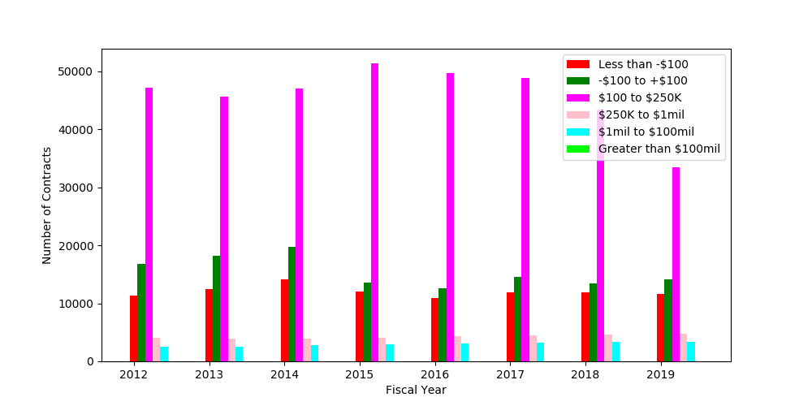
Contract distribution per fiscal year
ZACH
For all years most contracts are between $100 and $250K
Contract distribution is relatively consistent between years

Slide 6
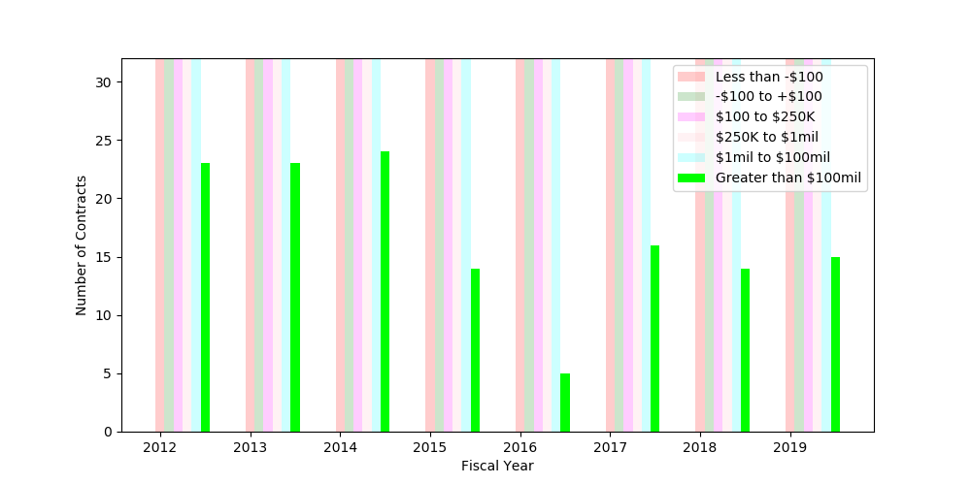
Contract distribution per fiscal year
ZACH
Lower number of contracts over $100 million after 2014

Slide 7
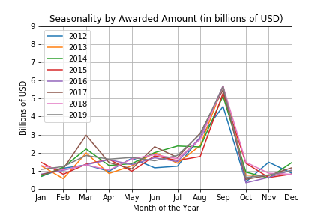
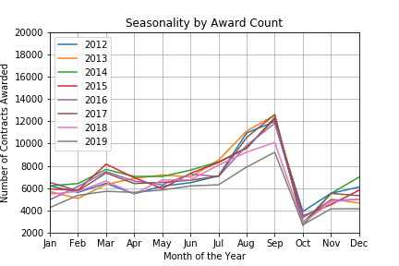
When are contracts being awarded?
JORGE
Seasonality is evident when measured by award amount
More awards in dollar terms concentrate in the last quarter of the fiscal
When removing the contract size from the analysis the seasonality is still evident
This result is consistent throughout the sample and independent from award size

Slide 8
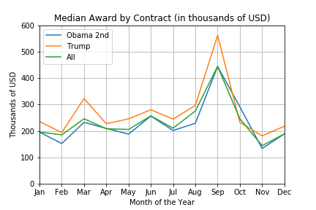
Is Seasonality unrelated with gov. administration?
JORGE
Evidence suggests that seasonality is a characteristic of the business cycle and is not particularly related with government administration
However, we found that the median award size was higher throughout the year during the current administration vs. the previous

Slide 9
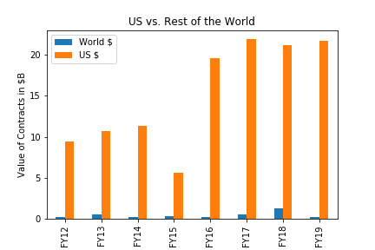
Overall spending on outsourcing domestic vs. foreign
Overall, the trend has been that US Spending has increased significantly over the past 8 years. Foreign spending accounts close to 3% of HHS Spending in the US. In conclusion most of the spending and activities are in the US and very little is spent outside.
World Spending has been consistently low compared to US Spending for the past 8 years. An avg of 2.5 million is being spent
US Spending has significantly increased over the past 8 years. From 2012 – 2019 the spending has increased 130%. This significant jump is shown from 2016 onwards. It is interesting because it coincides with the Trump Administration in office. I did not expect to such a drastic change.
GAYATRI

Slide 10
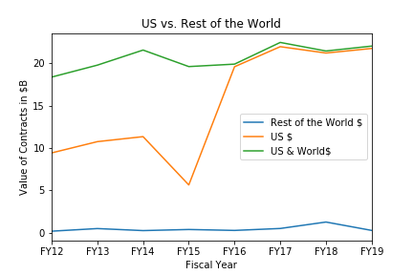
Data incomplete domestic vs. foreign
I had certain difficulties when it came to finding a complete data set. I was initially looking at just the US domestic spending of HHS. Unfortunately, certain US states had incomplete information.
World Spending had incomplete data. The data set had incomplete information under the country recipient column. In 2018 $1 billion was spent in foreign spending. Which was not consistent with the other 7 years
The dataset had a total of $165 billion of contracts across 2012-2019. Whereas, the total calculated HHS Spending when filtering by countries only totaled $125 billion. This indicates a data completeness issue. The issue is seen significantly seen through Obama’s 2nd administration and appears to improve significantly during the Trump administration.
US Spending had incomplete data from the HHS for the years. Some of the states. In 2015 there is a major dip in spending. from spending growing from $9 - $11 billion to a dip in $5 billion. I believe this is a because there was incomplete in the data set from the US states for 2015.
GAYATRI

Slide 11
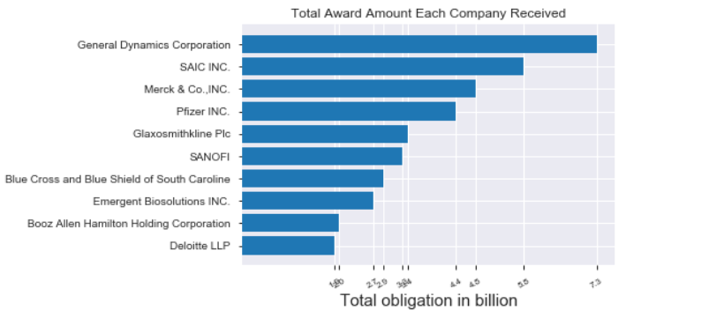
Total Dollar Amount Received By Top Ten Companies (2012-2019 total in billions of dollars)
RINA

Slide 12
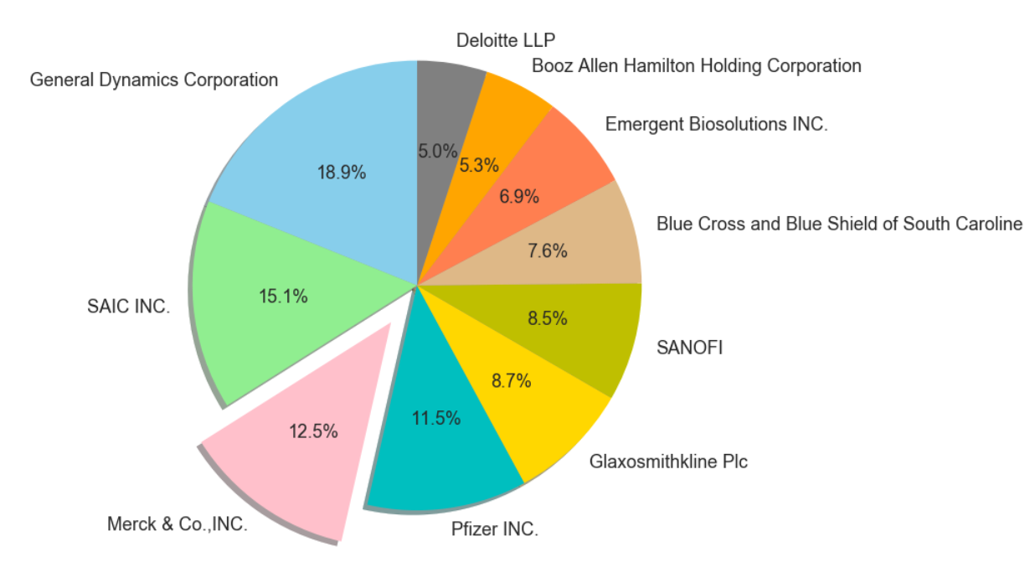
Comparison of Top Ten Companies within the Top Ten List
RINA

Slide 13
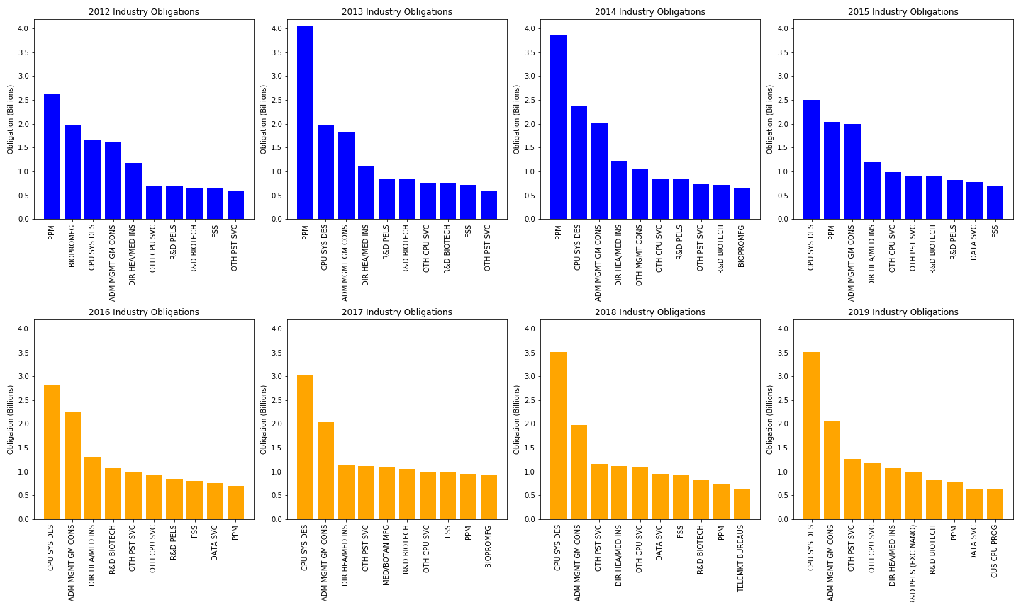
TOP 10 INDUSTRIES 2012-2019
Conclusion: Top 10 industries seem to simply be following technology trends in a rapidly growing healthcare market expanding use of data; would need a larger study to verify
Most Frequent Top 3 Industries:
Pharmaceuticals (PPM)
Cost’s ~2.5 billion to bring a single drug to market
CPU Systems Design Services (CPU SYS DES)
Administrative Management and General Management Consulting (ADM MGMT GM CONS)
Various R&D industry categories tend to remain but fluctuate in the top 10
WILL

Slide 14
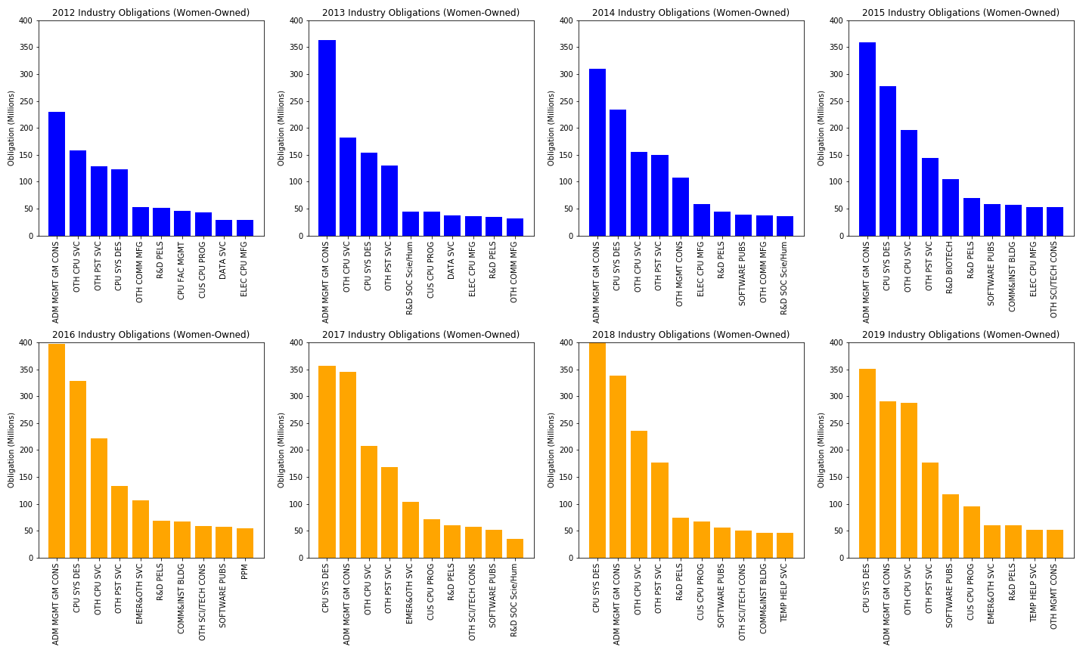
TOP 10 INDUSTRIES (Women-Owned) 2012-2019
Conclusion: Top 10 industries for women owned business are largely administrative services based and Information Technology based; trend follows suit with overall industry top 10
Where things differ:
Pharmaceuticals (PPM)
Only 1 instance of women-owned top 10 (2016)
0.34% of $15B
CPU Systems Design Services (CPU SYS DES)
2012: 7.34%
2019: 10.02%
$228m difference
Administrative Management and General Management Consulting (ADM MGMT GM CONS)
2012: 14.14%
2019: 14.06%
WILL

Slide 15
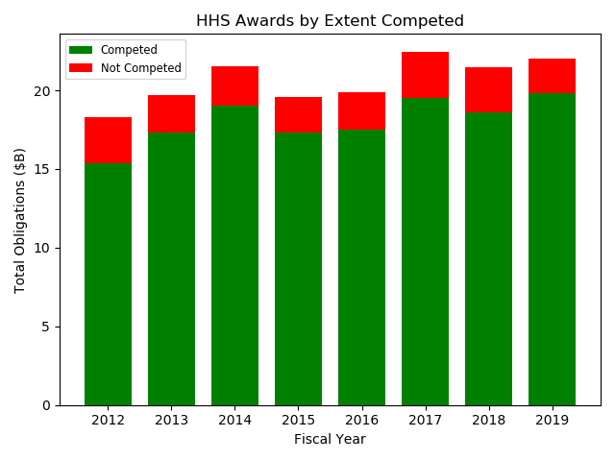
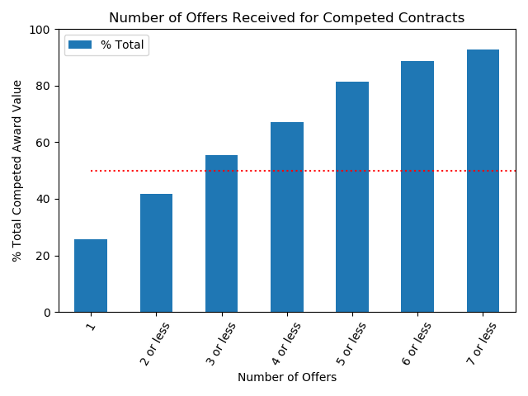
How competitive is the HHS supplier base?
STEVEN
Despite a majority of contracts being open for competition, nearly 25% of those contracts only received 1 offer in response to the solicitation
Additionally, over 50% of contracts open for competition only had 3 companies respond
Overall, the majority of contracts awarded were open for competition within the market
There was no indication that the administration in office impacted the number of contracts open for competition
Note: Chart is for years 2012-2019

Slide 16
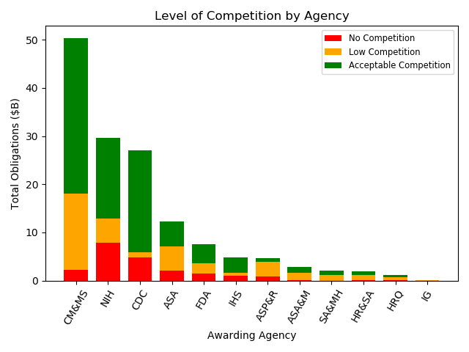
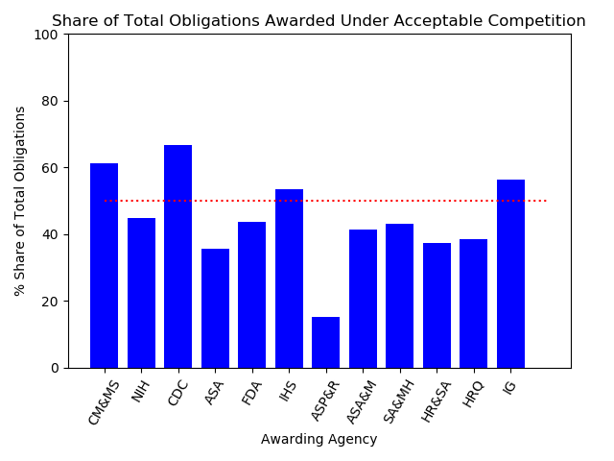
Does competition vary between agencies?
STEVEN
It appears that the level of competition varies between the agencies, with the top 3 controlling a majority of contracts awarded by HHS
There is little indication that contracts awarded by the larger agencies are more competitive
8 out of the 12 agencies within the HHS have awarded less than 50% of contracts under “acceptable competition”
No Competition: Contracts were exempt from opening for competition
Low Competition: Contracts were open for competition but only received 1-2 offers
Acceptable Competition: Contracts were open for competition and received 3+ offers
Note: Charts are for years 2012-2019

Slide 17
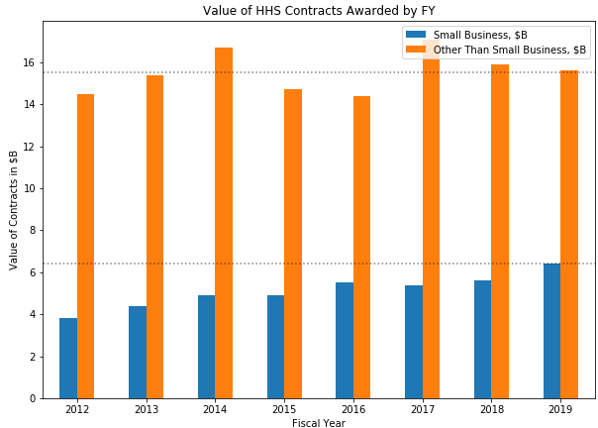
small vs. other businesses
Overall, while the trend is not steady, the value of All Contracts awarded between 2012 and 2019 has increased by 20%
The value of Other Than Small Business contracts has stayed relatively constant over the period 2011-2019
Annual Average = $15.5B
The value of Small Business contracts has increased by 68% over the same period, at a fairly steady pace
Max in 2019 = $6.4B
There’s no perceptible change in the trend between presidential administrations
SUMITA

Slide 18
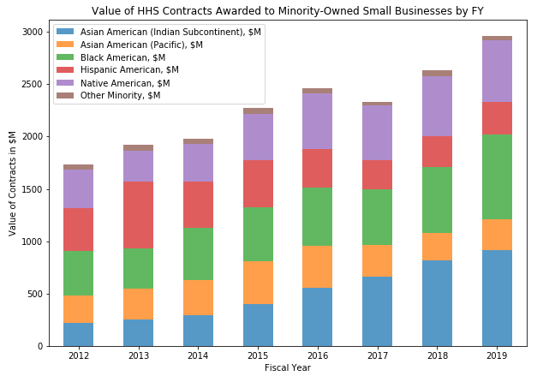
Minority small Business Trends
The total value of contracts awarded to minority small businesses has increased almost every year during this period (except 2017, but there have been significant gains since then)
There is significant variation in rates of change between the kinds of minorities represented in the dataset
~4x increase: Asian American (Indian)
~ 1.5x increase: Asian American (Pacific) and Native American
~20% decrease: Hispanic American
Relatively unchanged: Other Minority
Overall:
The Indian-American owned businesses have done well irrespective of political administration
Hispanic owned businesses gained slightly in the Obama years and have lost ground in the Trump years
SUMITA

Slide 19
CONCLUSIONS

Slide 20
CONCLUSIONS
Over the period 2012-2019, HHS has outsourced $165B of products and services
HHS outsourcing has grown by 20% over 8 years, there’s no discernible difference in the trend between administrations
While contracts have been awarded to 45 foreign countries, more than 99% of contract dollars are attributable to US companies
Low competition can lead to the government paying higher prices for goods and services. Despite most HHS contracts being open for competition, the data shows that there are very few companies that are fighting for each contract.
Given another 2 weeks, the team would have delved deeper into the causality of the trends seen
NOTICEABLE DIFFERENCE IN OBAMA (Term 2) & CURRENT ADMINISTRATION | YES OR NO
VOLUME OF CONTRACTS AWARDED | NO
TIMING OF CONTRACT AWARDS (SEASONALITY) | NO
FOREIGN VS. DOMESTIC CONTRACT AWARDS & ACCURACY OF LOCATION DATA | NO & YES
TOP 10 COMPANIES GAINING HHS BUSINESS | NO
INDUSTRIES GAINING HHS BUSINESS | ?
DEGREE OF COMPETITION | NO
OUTSOURCING TO SMALL BUSINESSES AND MINORITY-SMALL BUSINESSES | NO & YES

